Slide 1
Discoveries - False or Real
Akshaj Kammari

Slide 2
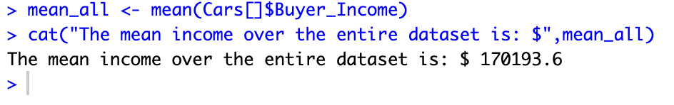
Mean Buyer’s Income over the entire Data Set Cars2023c.csv

Slide 3
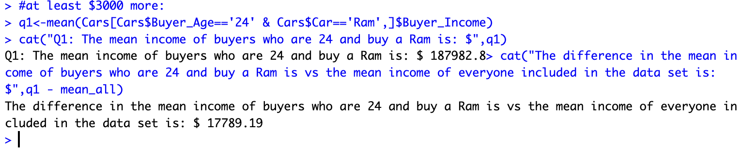
Q1
Q1 returns the mean buyer income which is at least $3000 higher than the mean buyer's income of over the entire dataset Cars2023c.csv. Return also the difference between the mean reported by the query and mean(Cars$Buyers_Income)

Slide 4
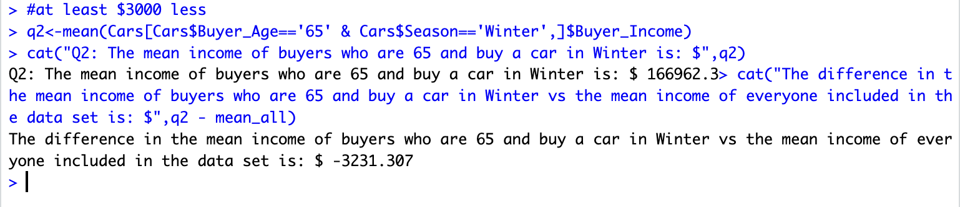
Q2
Q2 returns the mean buyer income which is at least $3000 lower than the mean buyer's income of over the entire dataset Cars2023c.csv. Return also the difference between the mean reported by the query and mean(Cars$Buyers_Income)

Slide 5
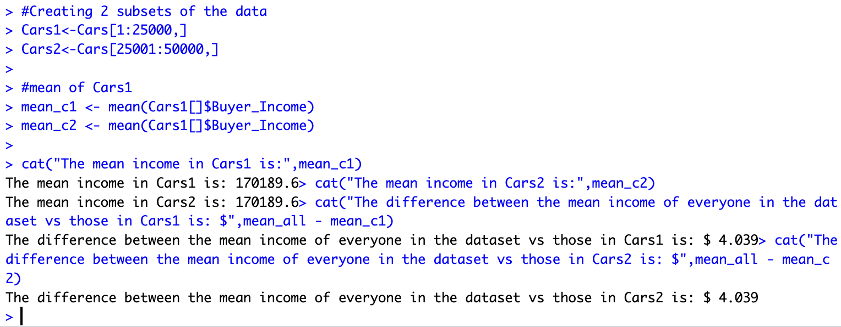
Cross Validation Part 1

Slide 6
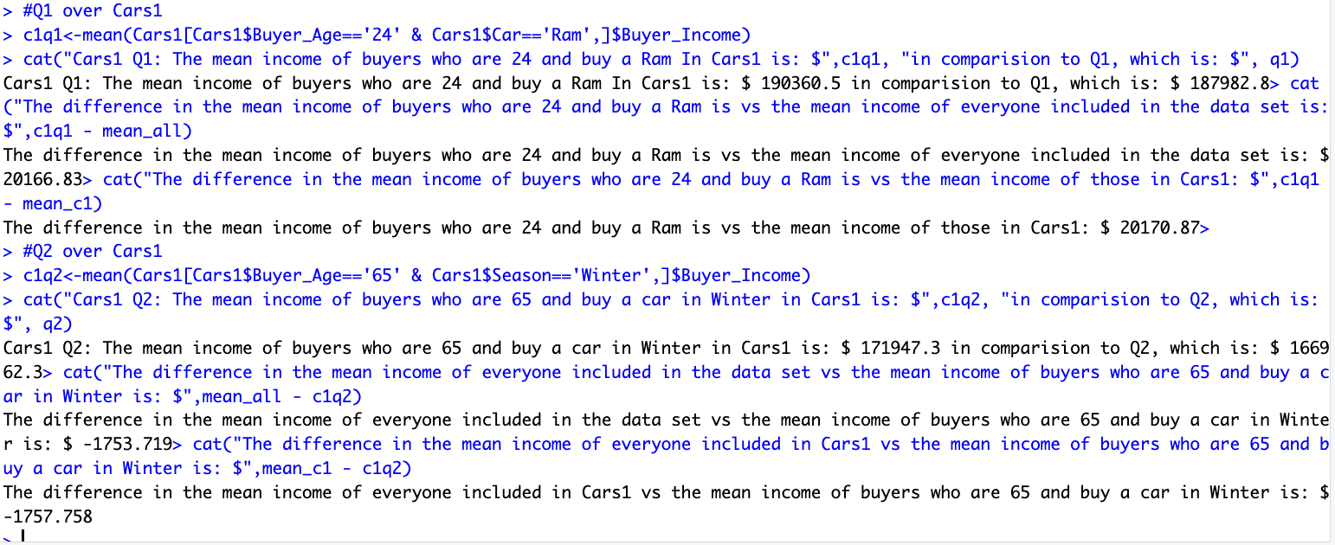
Cross Validation Part 2

Slide 7
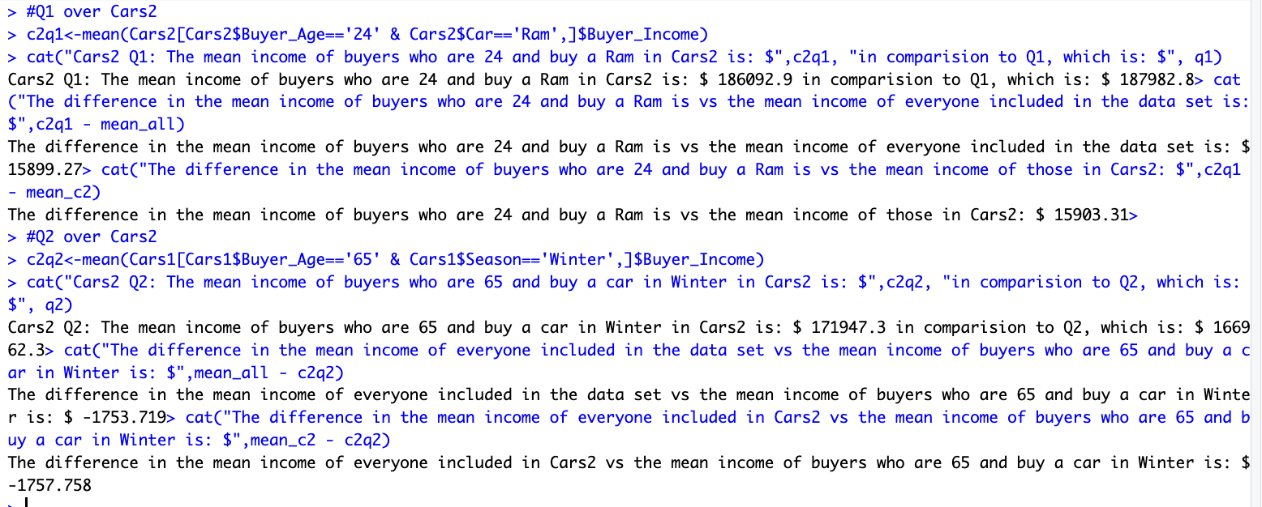
Cross Validation Part 3

Slide 8
Evaluation/Summary of Cross Validation
The mean values of Cars1 and Cars2 are exactly equal, and their differences from the mean value of everyone in the dataset was only $4.039
The mean income of the queries in Cars1 and Cars2 only differed within a maximum of $5000 vs the mean income of everyone in the dataset
This led to the queries applied to Cars1 and Cars2 having very similar values as the queries applied to the whole dataset
I am able to conclude with this information that the discrepancies faced when the dataset is split is REAL, not just random

